Slide 1
Linear Algebra Review
Dr. Frank Wood
TexPoint fonts used in EMF.
Read the TexPoint manual before you delete this box.: AAA

Slide 2
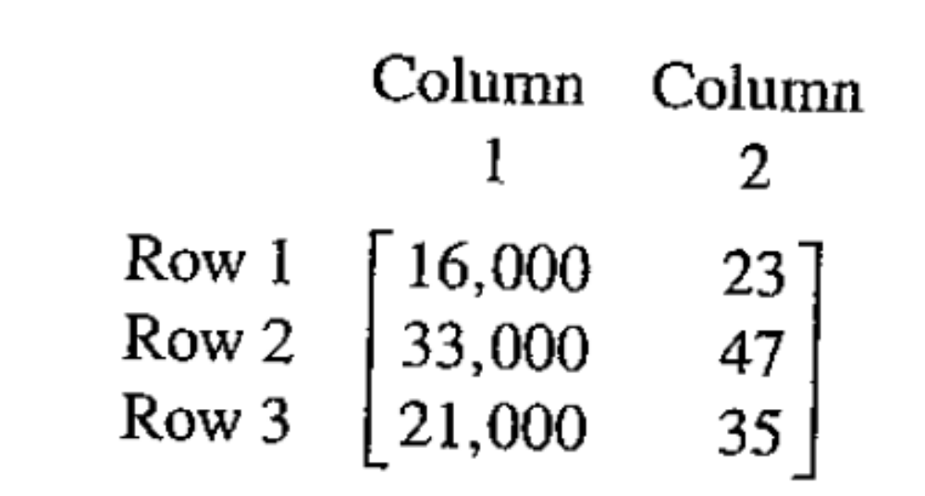
Definition of Matrix
Rectangular array of elements arranged in rows and columns
Dimension is number of rows and columns expressed as 3x2

Slide 3
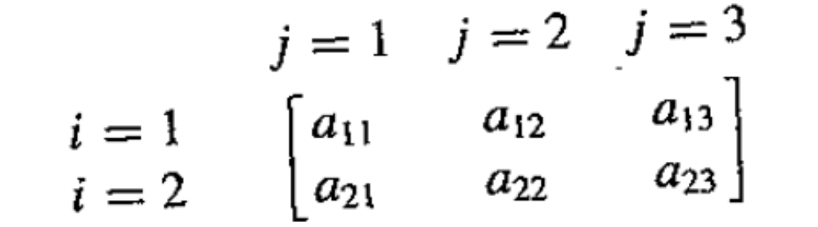
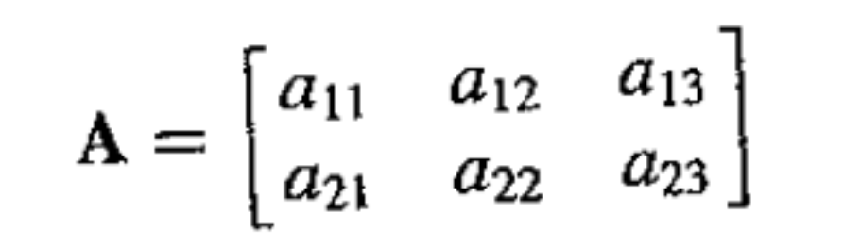
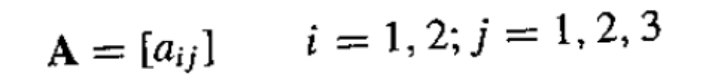
Indexing a Matrix

Slide 4
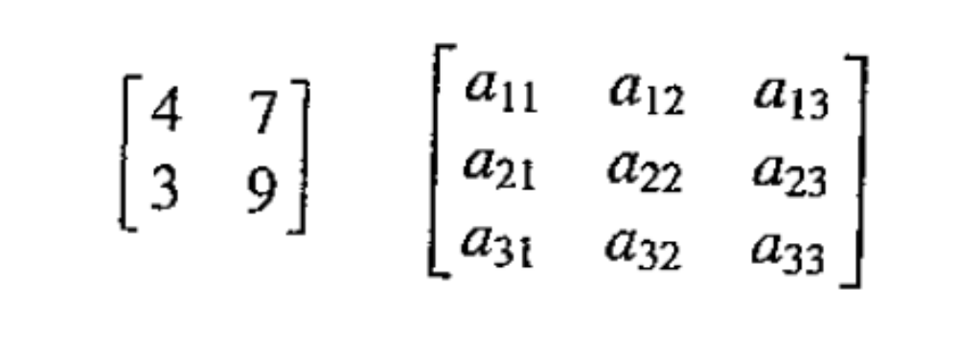
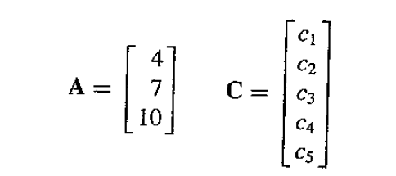
Square Matrix & Column Vector
Square matrix has equal number of rows and columns
A (column) vector is a matrix with a single column

Slide 5
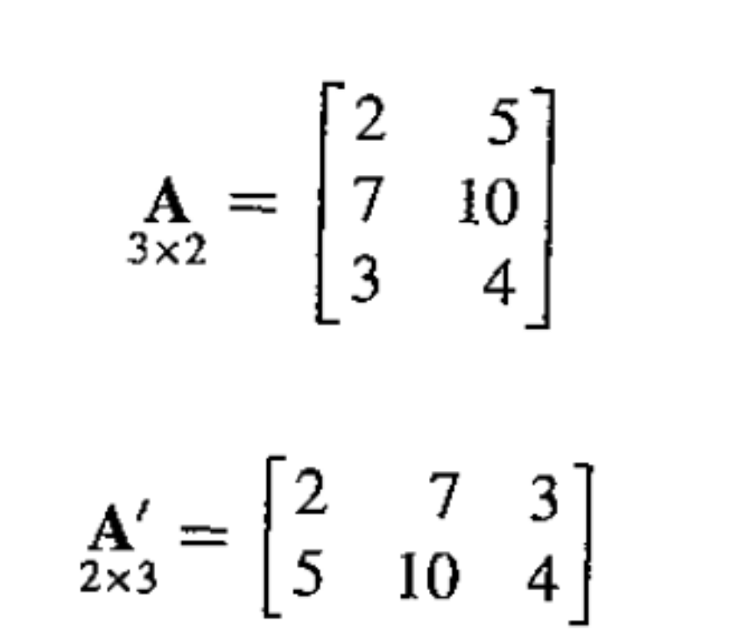
Transpose
The transpose of a matrix is another matrix in which the rows and columns have been interchanged

Slide 6
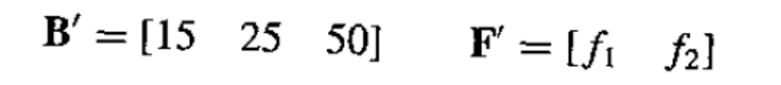
Row Vector
A row vector is the transpose of a column vector or a matrix with a single row

Slide 7
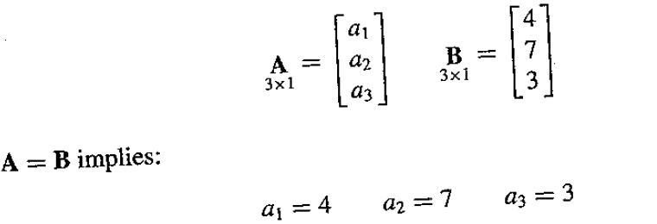
Equality of Matrices
Two matrices are the same if they have the same dimension and all of the elements are equal

Slide 8
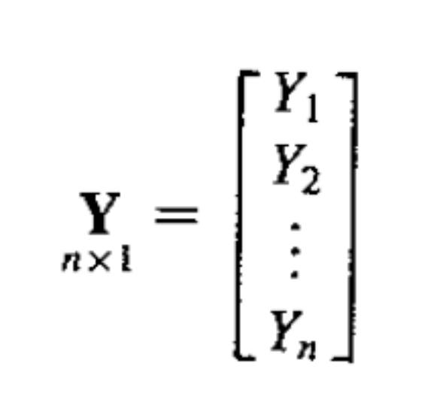
Regression Examples
Response matrix (vector)

Slide 9
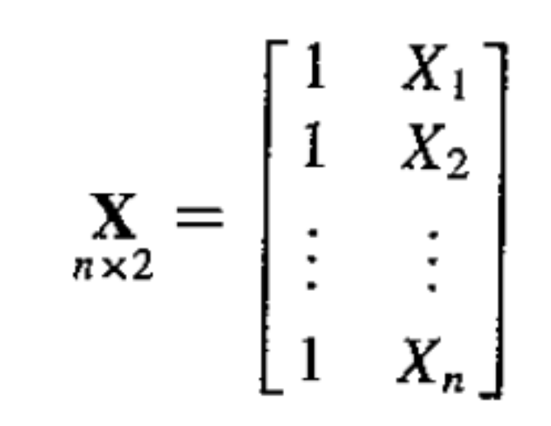
Regression Examples
Design matrix

Slide 10
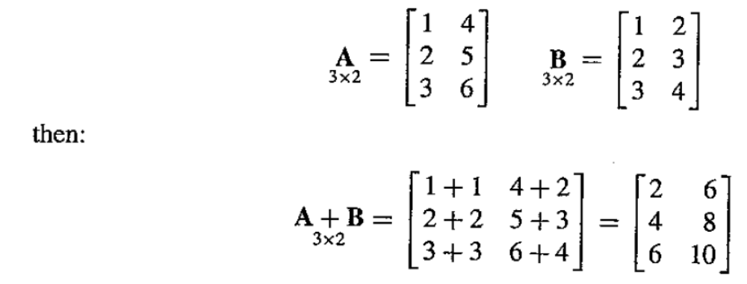
Matrix Addition and Subtraction

Slide 11
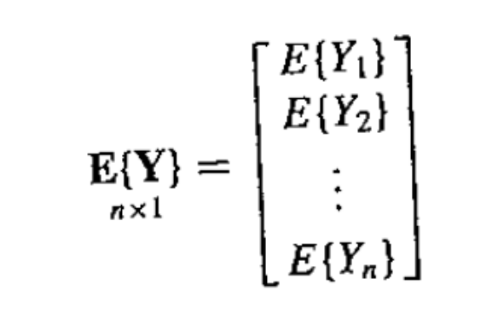
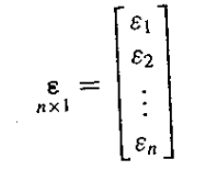
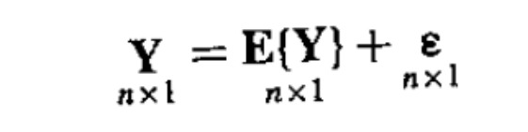
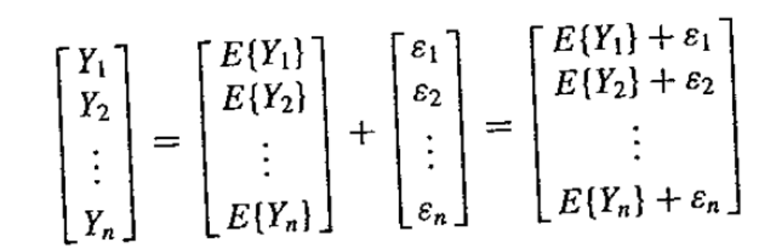
Regression Example

Slide 12
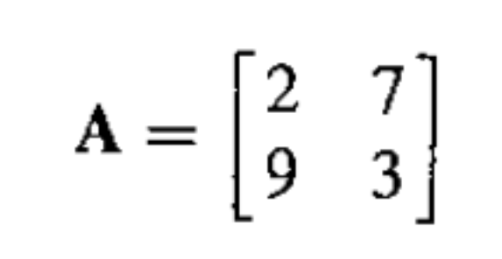
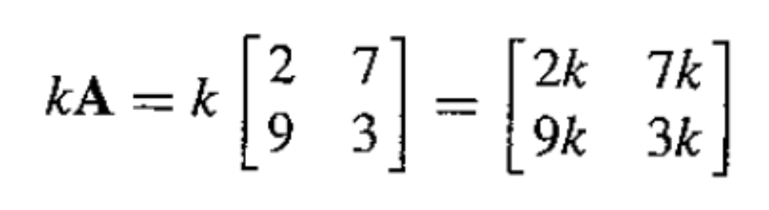
Multiplication of a Matrix by a Scalar

Slide 13
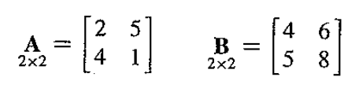
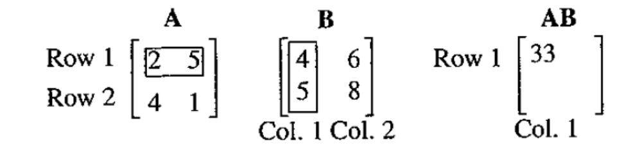
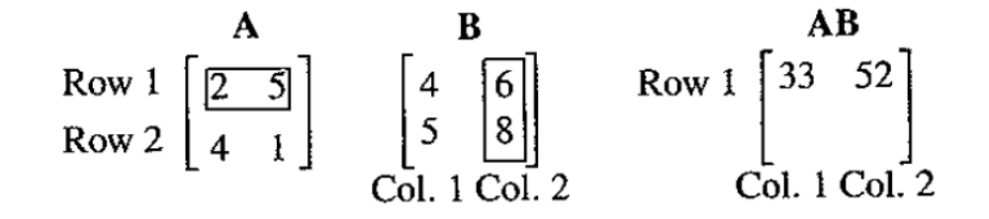
Multiplication of two Matrices

Slide 14
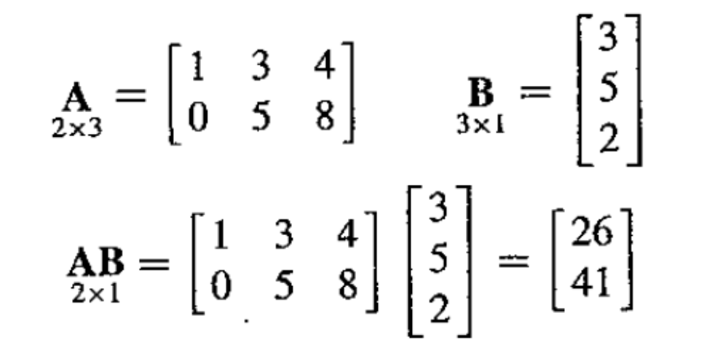
Another Matrix Multiplication Example

Slide 15
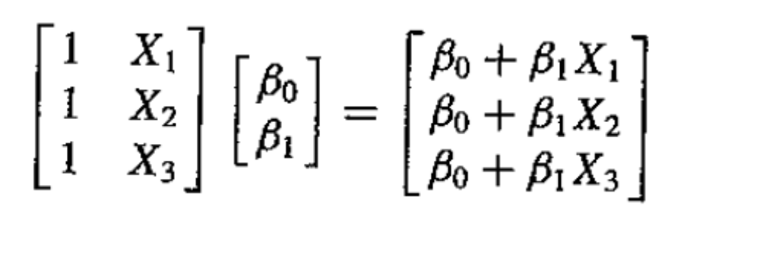
Regression Examples

Slide 16
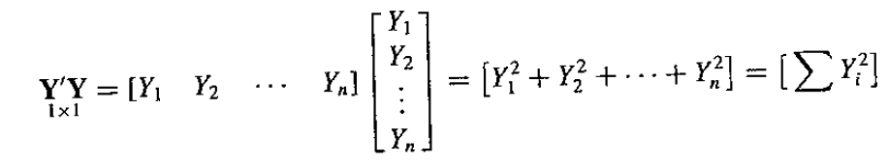
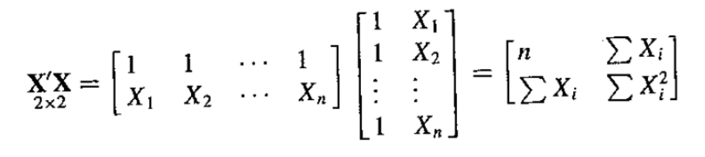
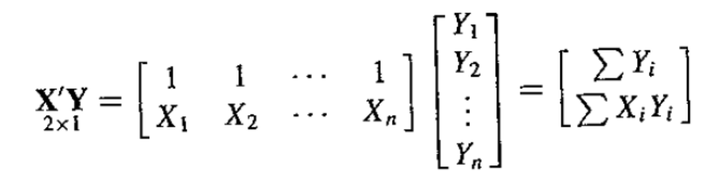
More Regression Examples

Slide 17
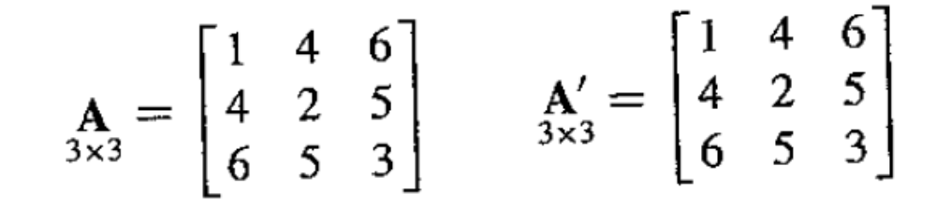
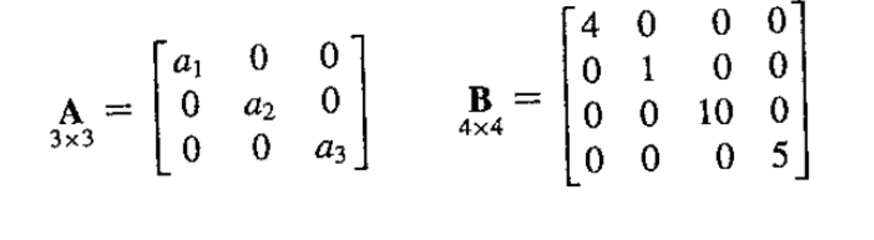
Special Matrices
If A = A’ then A is a symmetric matrix
If the off-diagonal elements of a matrix are all zeros it is called a diagonal matrix

Slide 18
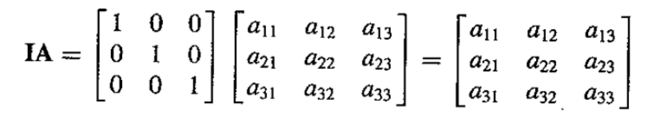
Indentity Matrix
A diagonal matrix whose diagonal entries are all one is an identity matrix. Multiplication by an identity matrix leaves the (pre or post) multiplied matrix unchanged.

Slide 19
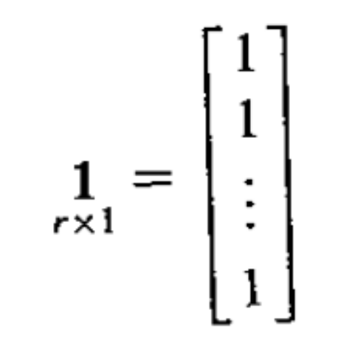
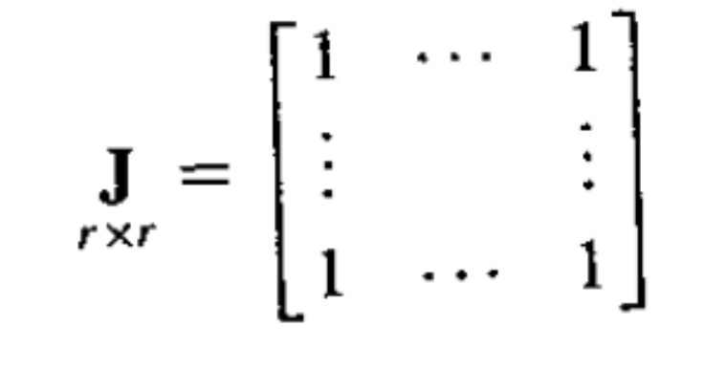
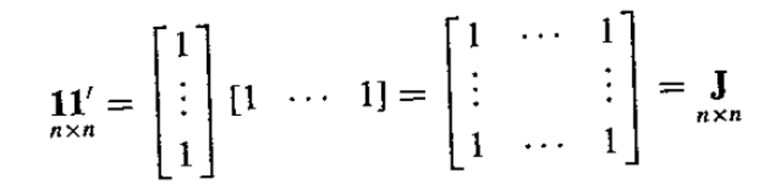
Vector and Matrix with all Elements = 1

Slide 20
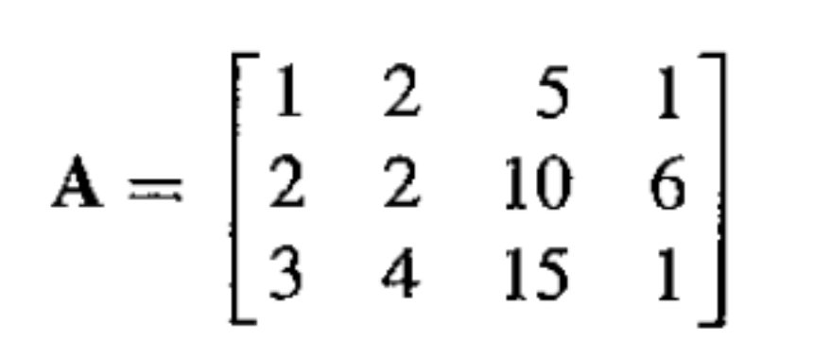
Linear Dependence and Rank of Matrix
Consider
and think of this as a matrix of a collection of column vectors. Note that the third column vector is a multiple of the first column vector

Slide 21
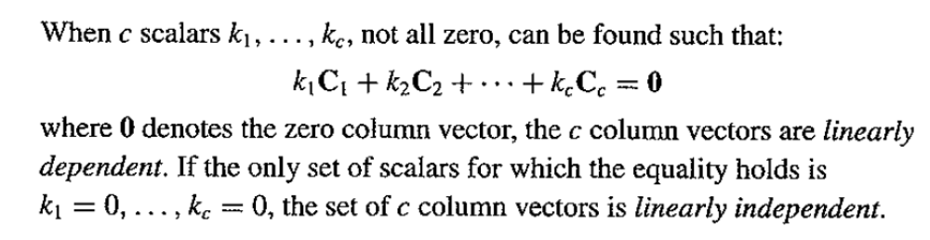
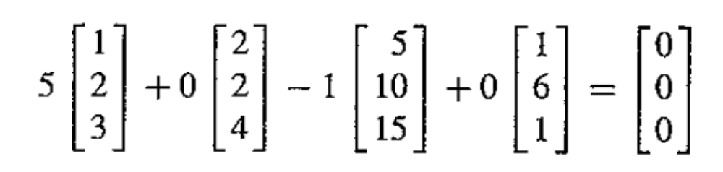
Linear Dependence

Slide 22
Rank of Matrix
The rank of a matrix is defined to be the maximum number of linearly independent columns in the matrix.
  The rank of a matrix is unique
  Can equivalently be defined as the maximum number of linearly independent rows
  The rank of an r x c matrix cannot exceed min(r,c)

Slide 23
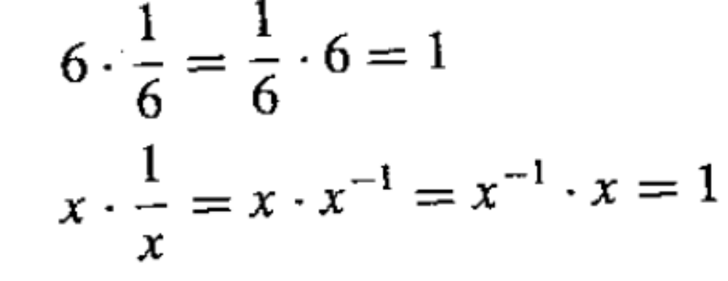
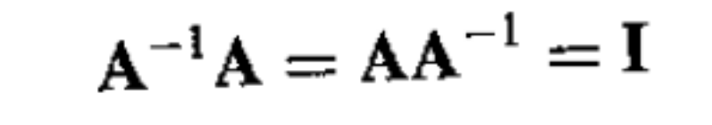
Inverse of a Matrix
Like a reciprocal
But for matrices

Slide 24
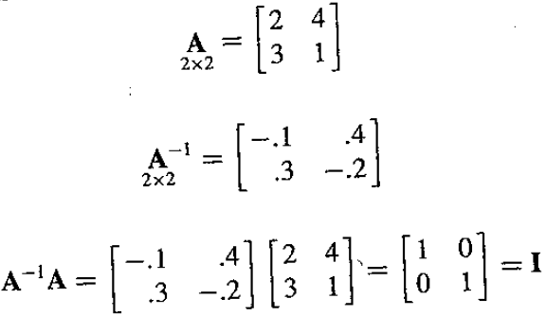
Example

Slide 25
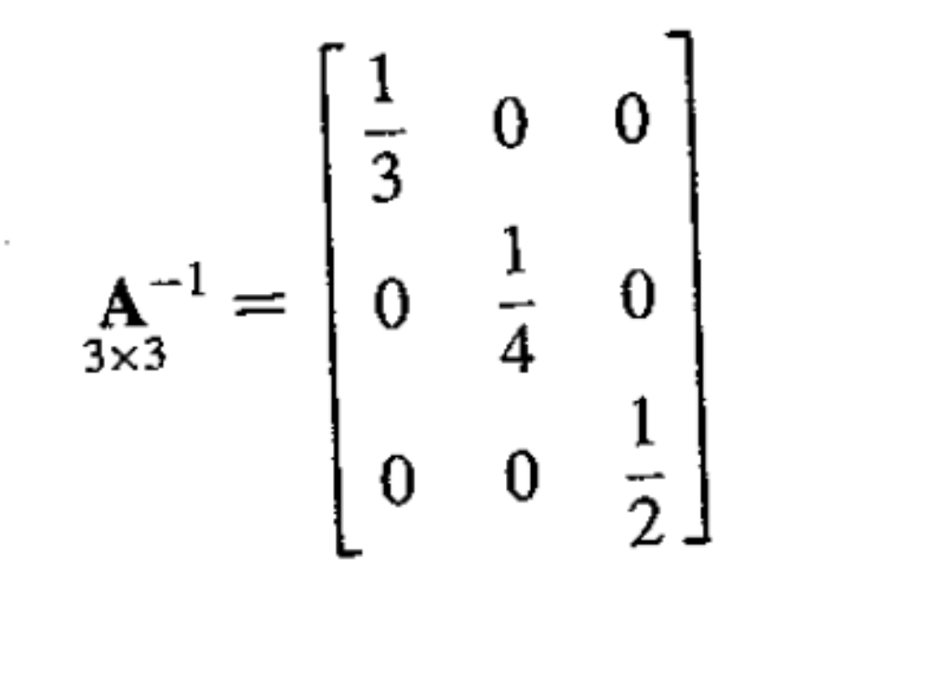
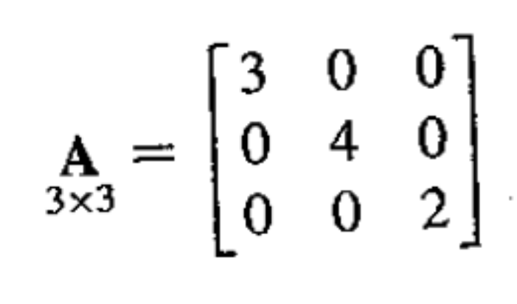
Inverses of Diagonal Matrices are Easy

Slide 26
Relation of Rank and Inverse
An inverse of a square r x r matrix exists if the rank of the matrix is r.
Such a matrix is said to nonsingular (or full rank)
An r x r matrix with rank less than r is said to be singular and does not have an inverse
The inverse of an r x r matrix of full rank also has rank r.

Slide 27
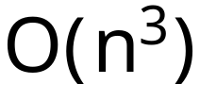
Finding the Inverse
Finding an inverse takes (for general matrices with no special structure)
operations (where n is the number of rows in the matrix)
We will assume that numerical packages can do this for us.

Slide 28
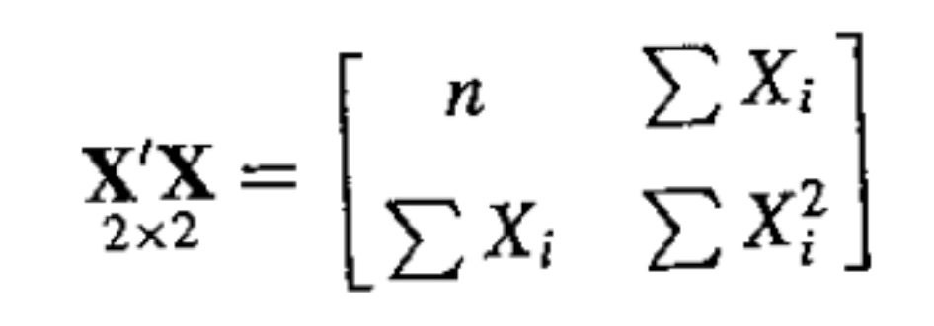
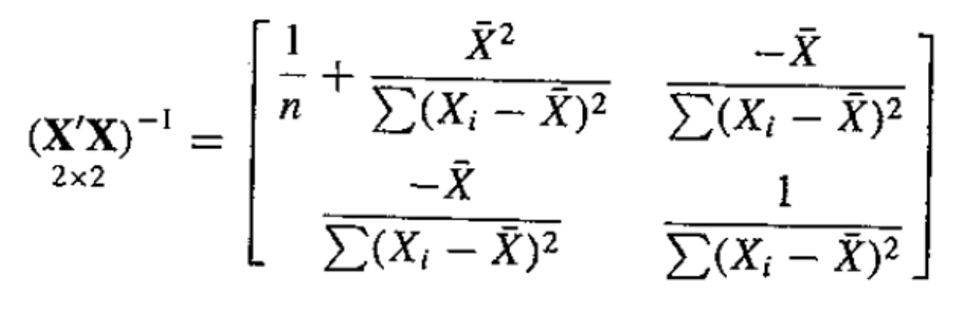
Manual Inverse Finding
For small matrices it is possible to find an analytic matrix inverse
Example

Slide 29

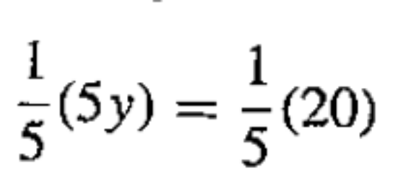
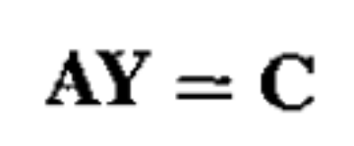
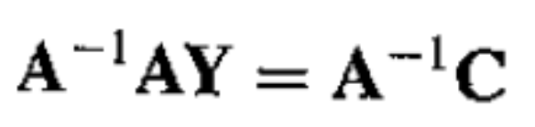

Uses of Inverse Matrix
Ordinary algebra
is solved by
Linear algebra
is solved by

Slide 30
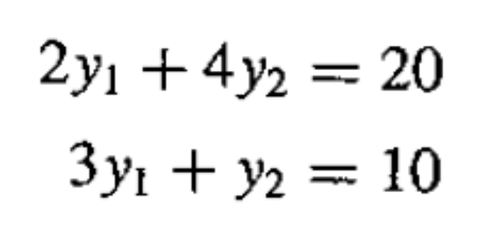

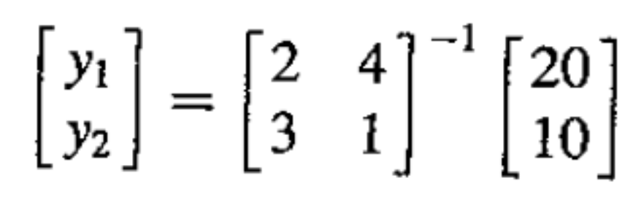
Example
Solving a system of simultaneous equations

Slide 31
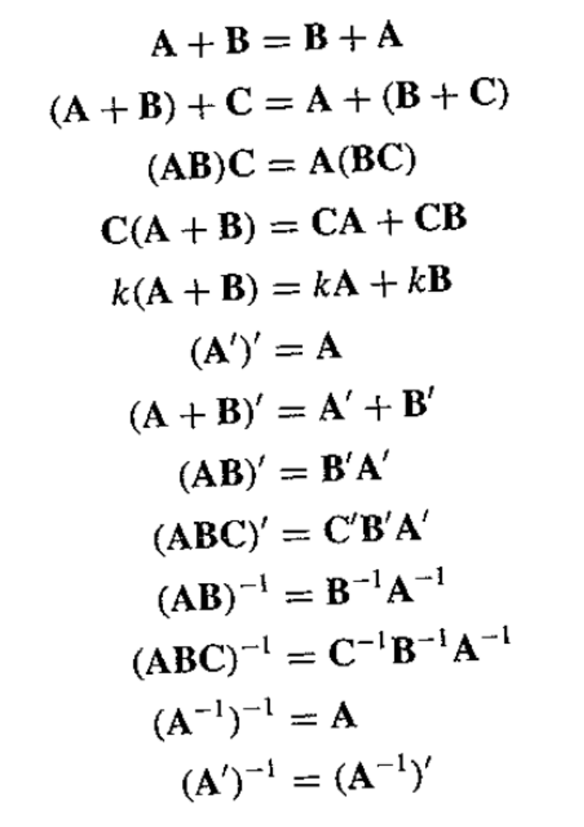
List of Useful Matrix Properties

